Slide 1

Search Filter

Slide 2
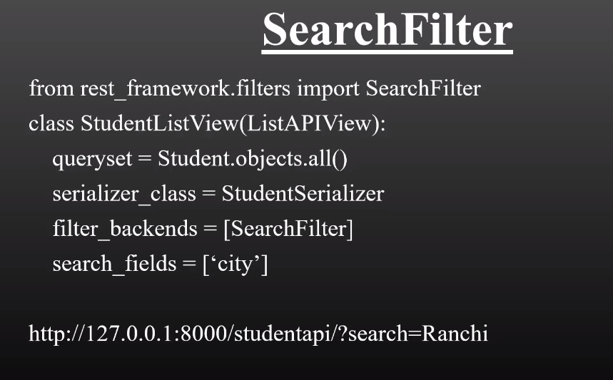

Slide 3
